Slide 1
Best Practices of a Software Craftsman
The skills it took years to learn to need
Devlin Liles
Improving Enterprises

Slide 2
Software Craftsman
What does it mean?
What do they do?
How is that different?

Slide 3
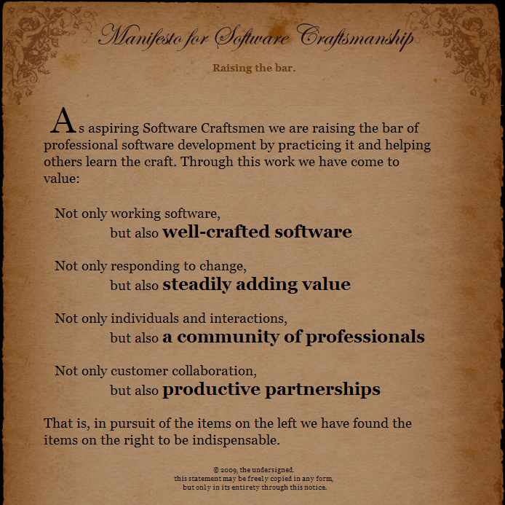

Slide 4
Be Professional and Unflinching
Have a minimum level of quality that is acceptable
Be Prepared to say “No” to people that can fire you
Friends don’t let friends code ….

Slide 5
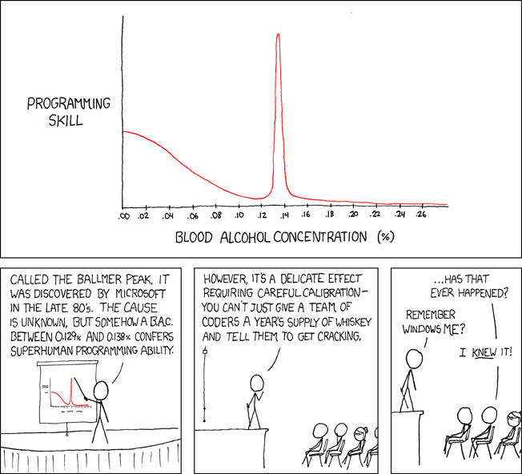
Drunk
Image at xkcd

Slide 6

Without Tests

Slide 7

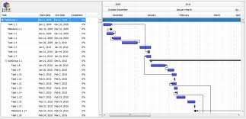
Without Requirements

Slide 8
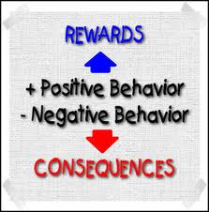
How do we accomplish this?
Treat your code like a child

Slide 9

How do we accomplish this?
Be a gamer at heart ( not the weird ones that never leave the house )

Slide 10
Deploy, Deploy, Deploy
Deploy Early, Deploy Often, Then Deploy some more
When you are done with that, use Robots to Deploy for you while you sleep!
It is the only way to avoid….

Slide 11
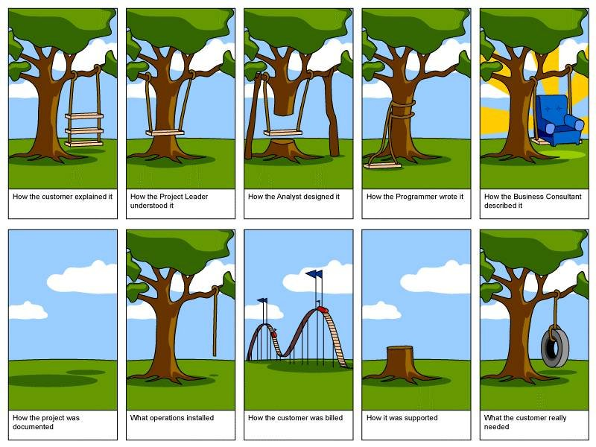

Slide 12
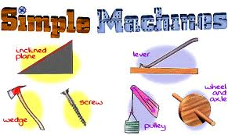
How do we accomplish this?
Do less work

Slide 13
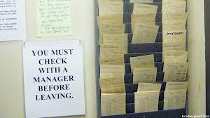
How do we accomplish this?
Don’t manage the automated process

Slide 14
Keeping up
Technology
Skills
Changes in the Industry
How do we…

Slide 15
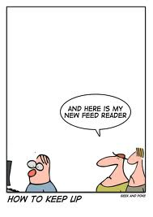
Keep Up

Slide 16
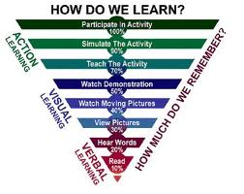
Find how you learn
Reading
Listening
Doing
Etc…

Slide 17

Take Time
Schedule it, and don’t change that

Slide 18
Tools we have talked about
Nuget – http://www.nuget.org/
BuildMaster - http://inedo.com/buildmaster/overview
PluralSight - http://www.pluralsight.com/training
Ncrunch - http://www.ncrunch.net/

